Slide 1
Presumptive Eligibility Tool ILT
PW and CH

Slide 2
Presumptive Eligibility Tool ILT: PW and CH
Introduction
In this course you will learn about the:
Goals of Presumptive Eligibility
Basics of the PE Tool
PE for Pregnant Women Tool
PE for Children Tool
Medical Consumer Self-Service Portal
Various Administrative Features in the Tool

Slide 3
Presumptive Eligibility Tool ILT: PW and CH
Agenda
Lesson 1: Overview
Lesson 2: PE Tool Basics
Lesson 3: PE PW
Lesson 4: PE CH
Lesson 5: MCSSP
Lesson 6: Administrative Features

Slide 4
Presumptive Eligibility Tool ILT: PW and CH
Lesson 1: Overview > PE Defined
Presumptive Eligibility (PE) is a program that provides temporary medical coverage for eligible persons at the time a medical service is provided. Only designated clinics and hospitals, referred to as Qualified Entities (QE), are able to determine eligibility for PE.
A goal of the PE program is to provide temporary medical coverage while the person successfully completes the KanCare application process.
Related to this is the PE program’s ultimate goal: to enroll eligible persons in ongoing KanCare coverage.

Slide 5
Presumptive Eligibility Tool ILT: PW and CH
Lesson 1: Overview > PE Defined
In addition to completing the PE determination, QE staff work with consumers to complete the KanCare application and obtain the verifications needed to determine eligibility.
The work of Qualified Entity staff is essential in meeting the goals of the PE program.

Slide 6
Presumptive Eligibility Tool ILT: PW and CH
Lesson 1: Overview > PE History
Prior to the KEES project, PE determinations were completed by using a paper Tool which was then faxed into the KanCare Clearinghouse.
This changed with the creation of a web-based Tool that was implemented during Phase 1 of KEES (approximately June 2012). The Phase 1 PE Tool completed determinations for the Presumptive Eligibility for Children (PE CH) program. Populated notices and release forms were also part of the Phase 1 PE Tool. Throughout Phase 1, QE staff continued to fax notices and releases to the KanCare Clearinghouse.

Slide 7
Presumptive Eligibility Tool ILT: PW and CH
Lesson 1: Overview > P2 Functionality
The Phase 2 PE Tool builds and expands upon this functionality. The main features of the new P2 PE Tool are:
A separate PE Tool for Pregnant Woman (PE PW).
A separate PE Tool for Adults (PE Adult).
Data as well as the results from the PE Tool will be automatically sent to the new eligibility system, KEES.

Slide 8
Presumptive Eligibility Tool ILT: PW and CH
Lesson 1: Overview > Summary
That completes Lesson 1. This Overview lesson discussed the:
  Definition of PE
  Goals of PE
  Phase 1 PE Tool
  Phase 2 PE Tool
We will review PE Tool Basics next.

Slide 9
Presumptive Eligibility Tool ILT: PW and CH
Agenda
Lesson 1: Overview
Lesson 2: PE Tool Basics
Lesson 3: PE PW
Lesson 4: PE CH
Lesson 5: MCSSP
Lesson 6: Administrative Features

Slide 10
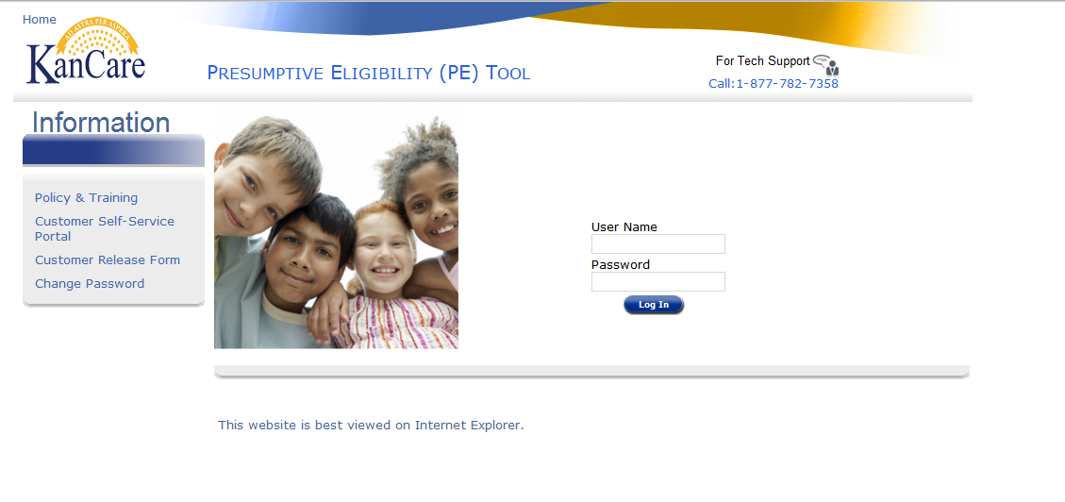
Presumptive Eligibility Tool ILT: PW and CH
Lesson 2: PE Tool Basics > Login
As mentioned in the previous lesson, the Presumptive Eligibility (PE) Tool is a web-based application. It is accessed via a URL or link on the Internet. Upon clicking the link, the Login to the PE Tool is displayed.

Slide 11
Presumptive Eligibility Tool ILT: PW and CH
Lesson 2: PE Tool Basics > Login Page
On this page, the following can be found:
Username and Password Text boxes
Links to:
  Policy and Training
  Medical Consumer Self-Service Portal
  Customer Release Form
  Change Password
The number for Tech Support

Slide 12
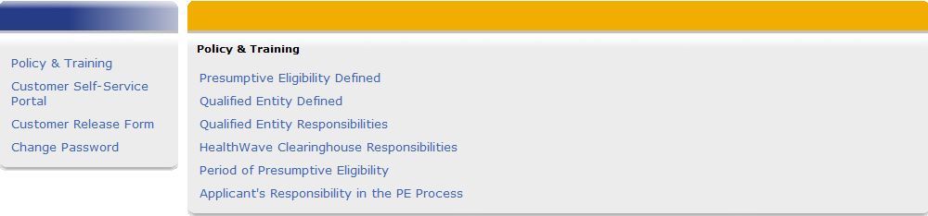
Presumptive Eligibility Tool ILT: PW and CH
Lesson 2: PE Tool Basics > Login Page > Policy and Training Links
Policy and Training is the first link on the Login page. Clicking this link navigates the user to various Policy references and mandates that pertain to Presumptive Eligibility. Each reference is a hyperlink that directs the user to the related information.

Slide 13
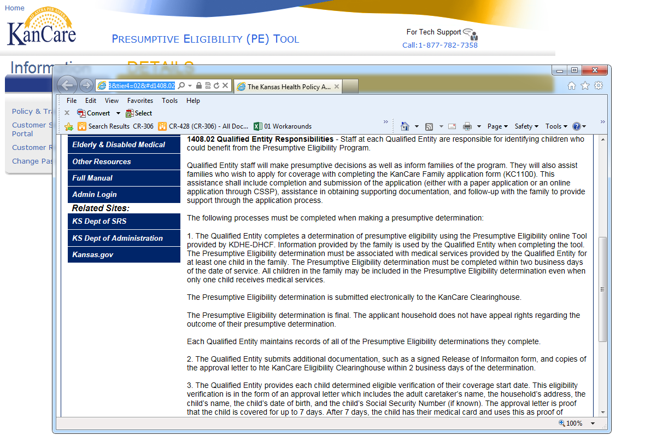
Presumptive Eligibility Tool ILT: PW and CH
Lesson 2: PE Tool Basics > Login Page > Policy and Training Links
The Policy and Training information will display in a separate pop-up window. Click the X at the top right-hand side of the pop up window to return to the PE Tool.

Slide 14
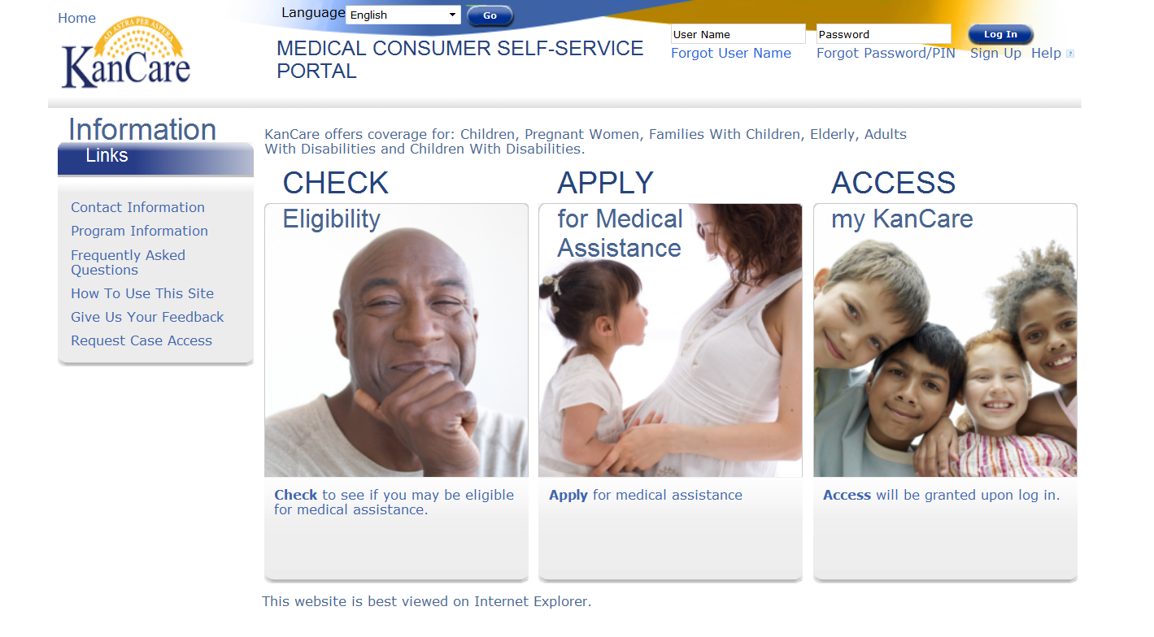
Presumptive Eligibility Tool ILT: PW and CH
Lesson 2: PE Tool Basics > Login Page > MCSSP Links
The next link is to the Medical Consumer Self-Service Portal (MCSSP). The MCSSP is a web-based application for KanCare benefits.

Slide 15
Presumptive Eligibility Tool ILT: PW and CH
Lesson 2: PE Tool Basics > Login Page > MCSSP Links
An overview of the different sections of the MCSSP is listed below. More information about completing the MCSSP application will be discussed in Lesson 5.
Check Eligibility
A self-assessment to check for potential eligibility.
Apply for Medical Assistance
Web-based application for all medical programs.
Access my KanCare
Access to submitted MCSSP applications.

Slide 16
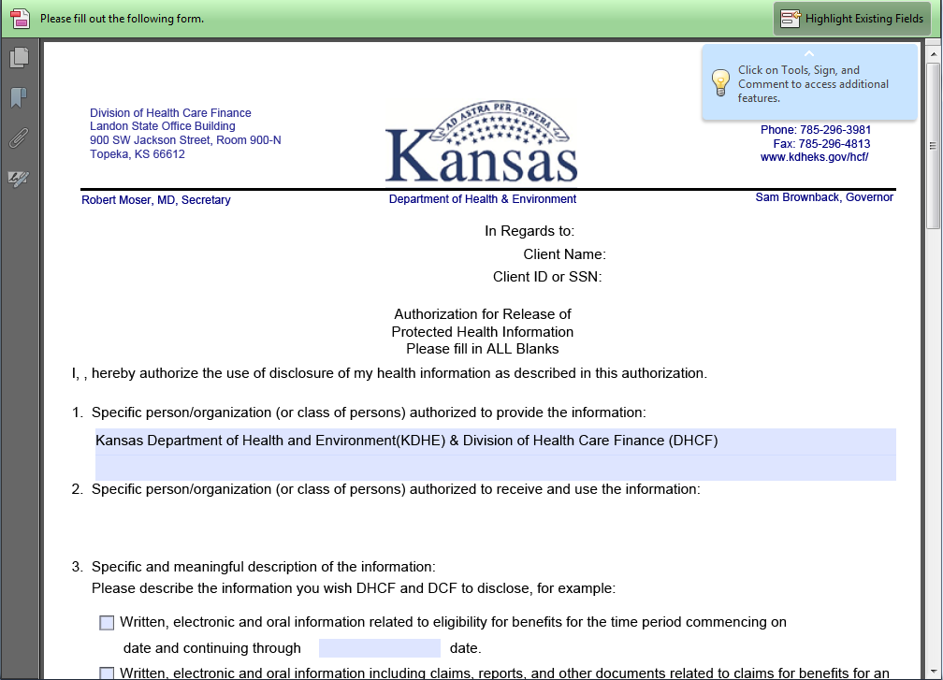
Presumptive Eligibility Tool ILT: PW and CH
Lesson 2: PE Tool Basics > Login Page > Customer Release Form
A blank Customer Release form can also be accessed on the login page. QE staff can use this if a Release form is needed outside the context of the PE Tool.

Slide 17
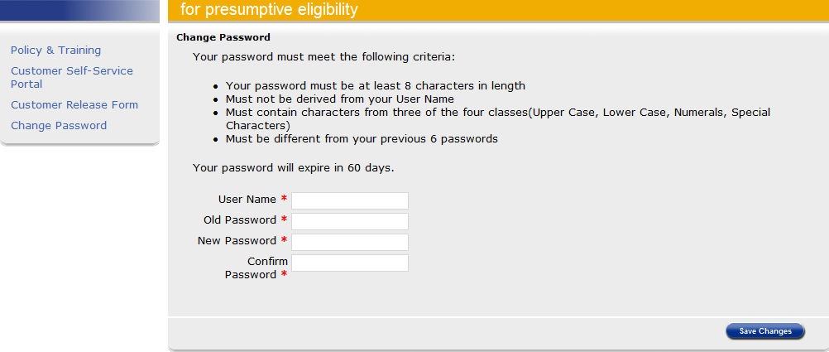
Presumptive Eligibility Tool ILT: PW and CH
Lesson 2: PE Tool Basics > Login Page > Change Password Link
The last link is used to change a password to the PE Tool. When you initially log into the PE Tool it’s recommended that you change your password.
To change a password, the User Name, Old Password, and New Password must be entered. The New Password must be entered again in the Confirm Password field.

Slide 18
Presumptive Eligibility Tool ILT: PW and CH
Lesson 2: PE Tool Basics > Login Page > Password Criteria
The following criteria pertains to the PE Tool password:
It needs to be changed every 60 days.
If the password isn’t changed within 60 days, it will expire and lock the QE staff out of the PE Tool.
A message will display 15 days before the password expires.
Contact Tech Support if your password has expired so it can be reset.

Slide 19
Presumptive Eligibility Tool ILT: PW and CH
Lesson 2: PE Tool Basics > Login Page > Password Criteria
Passwords to the PE Tool must:
Be at least 8 characters long
Contain 3 out of 4 of the following:
  Upper Case
  Lower Case
  Numerals
  Special Characters
Differ from the previous 6 passwords
Differ from your User Name

Slide 20
Presumptive Eligibility Tool ILT: PW and CH
Lesson 2: PE Tool Basics > Login Page > Tech Support
The Tech Support phone number is the final field on the Login page to review. QE Staff need to call this number when they have technical issues, password problems, or questions regarding the PE Tool.

Slide 21
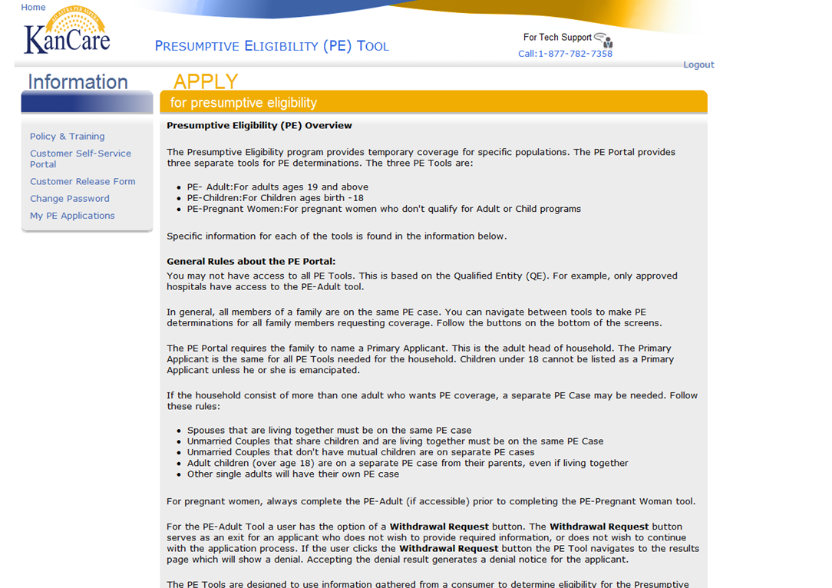
Presumptive Eligibility Tool ILT: PW and CH
Lesson 2: PE Tool Basics > Overview Page
After logging into the PE Tool, the PE Overview page is displayed. This page provides:
Definitions of the PE programs
General Rules of the PE Tool
Instructions on how to complete each of the PE Tools
We’ll review the General Rules of the PE Tools next.

Slide 22
Presumptive Eligibility Tool ILT: PW and CH
Lesson 2: PE Tool Basics > PE Overview > General Rules
QE Staff may not have access to all of the PE Tools.
The PE Adult Tool will only be provided to approved hospitals.
In most situations, all family members should be on the same PE case.
Navigate between the Tools to complete determinations for all family members.
When multiple family members apply for PE the Tools must be completed in a specific order.
The order to follow when using multiple Tools for a single household is
PE Adult > PE PW > PE CH
A Primary Applicant is needed for all PE Tools.
The Primary Applicant must be the same for all PE Tools completed for a household.

Slide 23
Presumptive Eligibility Tool ILT: PW and CH
Lesson 2: PE Tool Basics > PE Overview > General Rules
Same PE Tool
Spouses living together
Unmarried Couples with mutual children who live together
Separate PE Tools
Unmarried couples with no mutual children
Adult children (over 18) even when living with their parents
Single adults
Children with different MAGI Households

Slide 24
Presumptive Eligibility Tool ILT: PW and CH
Lesson 2: PE Tool Basics > Primary Applicant Defined
In some situations, there will need to be more than one PE Tool completed for multiple children in the same home.
Each child’s determination is based on their own MAGI household, as explained in the PE Child Policy instructions.
In situations where the children in the home have different MAGI households, such as when the children are not siblings or have different parents living in the home. In these situations, separate PE Tools should be completed.

Slide 25
Presumptive Eligibility Tool ILT: PW and CH
Lesson 2: PE Tool Basics > Primary Applicant Defined
Primary Applicant Information is the first page for all of the PE Tools. This page is used to gather information regarding the person, parent, or caretaker who is the head of the household. The Primary Applicant may be applying for themselves and/or on behalf of others in their household. As stated earlier, the Primary Applicant is the same when multiple PE Tools are needed for a single household.
Primary Applicants are:
Adults
Legally Emancipated Minors

Slide 26
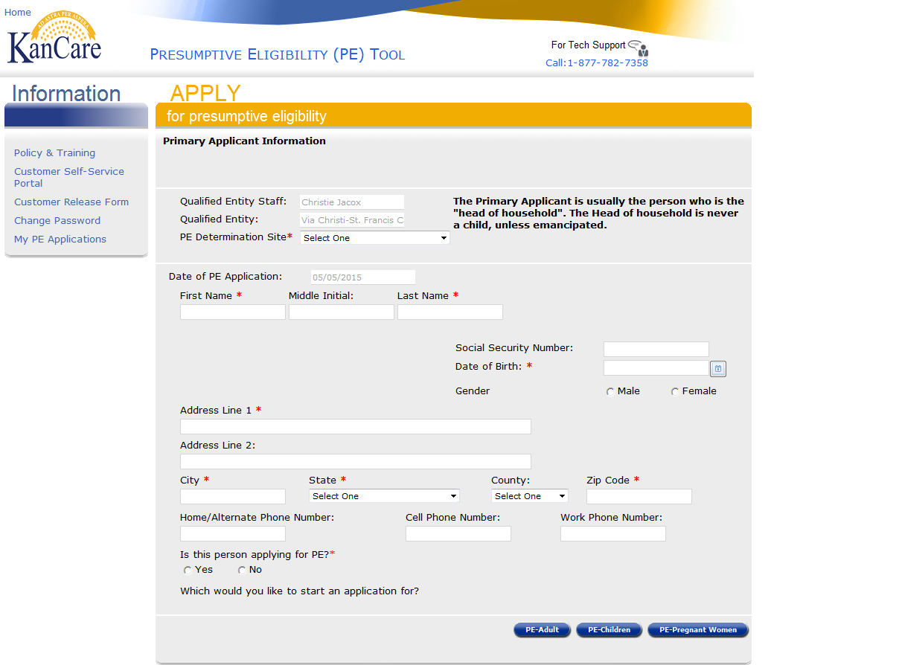
Presumptive Eligibility Tool ILT: PW and CH
Lesson 2: PE Tool Basics > Primary Applicant Information
The QE Staff and QE auto-populate based on the user’s login information.
Select the appropriate PE Determination Site.
The following information is needed for the Primary Applicant Information page:
First and Last Name
Date of Birth
Gender
Address
Applying for Self
Providing a Social Security Number is optional.
The Date of PE Application only populates after the Results have been accepted.

Slide 27
Presumptive Eligibility Tool ILT: PW and CH
Lesson 2: PE Tool Basics > Primary Applicant Information
Once the Primary Applicant Information page has been completed, you will need to choose which PE Tool to complete.
The PE Adult button will only display for QE staff working at hospitals who have also attended the necessary training for this program.
Our next lesson will focus on the PE PW Tool.

Slide 28
Presumptive Eligibility Tool ILT: PW and CH
Lesson 2: PE Tool Basics > Summary
That completes Lesson 2. In this lesson, we reviewed the following pages in the PE Tool:
  Login
  Overview
  General Rules
  Primary Applicant Information
The PE PW Tool will be discussed in the next lesson.

Slide 29
Presumptive Eligibility Tool ILT: PW and CH
Agenda
Lesson 1: Overview
Lesson 2: PE Tool Basics
Lesson 3: PE PW
Lesson 4: PE CH
Lesson 5: MCSSP
Lesson 6: Administrative Features

Slide 30
Presumptive Eligibility Tool ILT: PW and CH
Lesson 3: PE PW > PE PW Tool Screen Flow
Clicking the PE – Pregnant Woman button on the Primary Applicant Information page initiates the PE PW Tool. Below is the screen flow of the PE PW Tool.

Slide 31
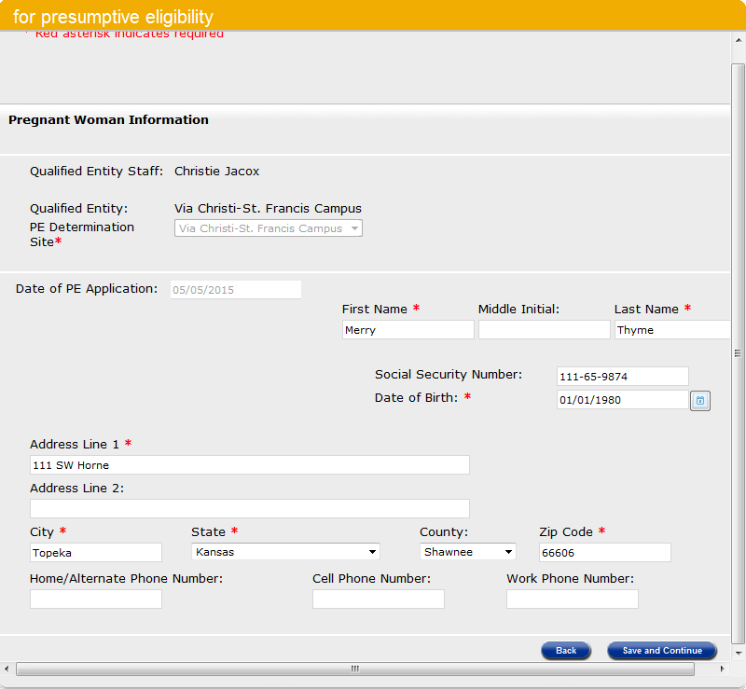
Presumptive Eligibility Tool ILT: PW and CH
Lesson 3: PE PW > Pregnant Woman Information
After clicking the PE – Pregnant Woman button on the Primary Applicant Information page, the Pregnant Woman Information page displays.
The following information is needed for a Pregnant Woman:
First and Last Name
Date of Birth
Address
Providing a Social Security Number is optional.
The PE Determination Site auto-populates from the Primary Applicant page.
The Date of PE Application only populates after the Results have been accepted.

Slide 32
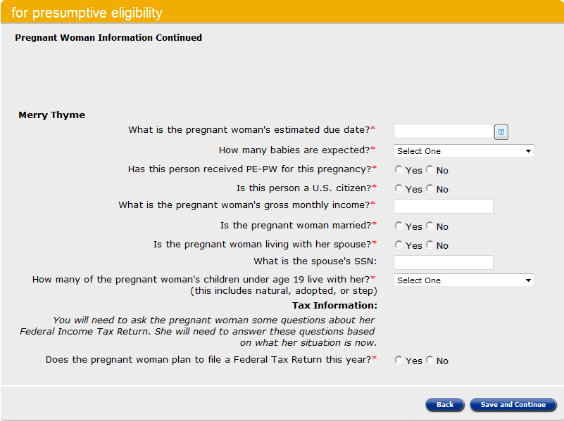
Presumptive Eligibility Tool ILT: PW and CH
Lesson 3: PE PW > Pregnant Woman Information Continued
The next page displayed is Pregnant Woman Information Continued.
The information listed below is required for this page:
Estimated Due Date
Number of Babies Expected
Previous PE for This Pregnancy
US Citizen/Eligible Non-Citizen
PW’s Gross Monthly Income
Marital Status
Living With Spouse
Number of PW’s Children Living With Her
Tax Information

Slide 33
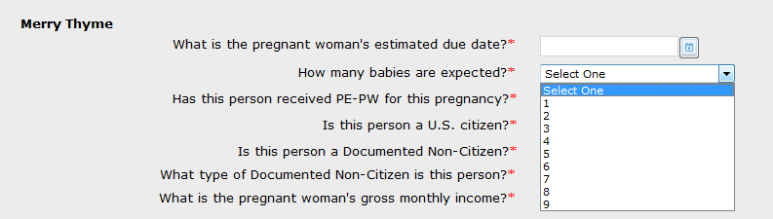
Presumptive Eligibility Tool ILT: PW and CH
Lesson 3: PE PW > Pregnant Woman Information Continued
There are several dropdown values on this page. The first is for the How many babies are expected? question.

Slide 34
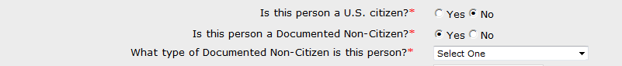

Presumptive Eligibility Tool ILT: PW and CH
Lesson 3: PE PW > Pregnant Woman Information Continued
If the consumer is not a U.S. Citizen and answers Yes for the Is this person a Documented Non-Citizen question, a dropdown will display to select the type of documented non-citizen.

Slide 35
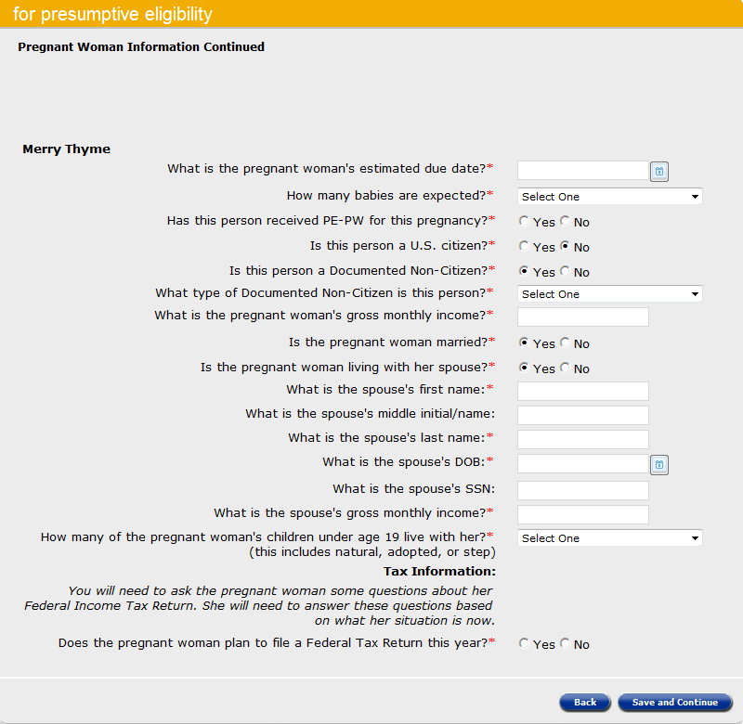
Presumptive Eligibility Tool ILT: PW and CH
Lesson 3: PE PW > Pregnant Woman Information Continued
If the Pregnant Woman indicates that she is married and living with her spouse, text box fields display requesting:
Spouse’s First and Last Name
Spouse’s Date of Birth
Spouse’s Gross Monthly Income
There is a field requesting the Spouse’s Social Security Number but this is not mandatory.

Slide 36
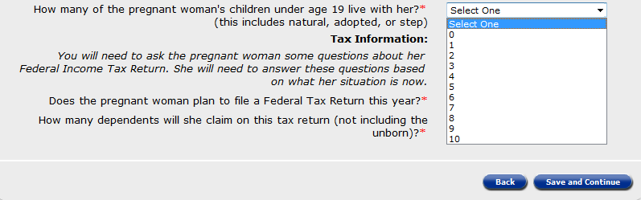
Presumptive Eligibility Tool ILT: PW and CH
Lesson 3: PE PW > Pregnant Woman Information Continued
A dropdown will display to indicate the number of children under the age of 19 that live with the Pregnant Women. Make sure to include adopted and stepchildren along with those who are biological.

Slide 37
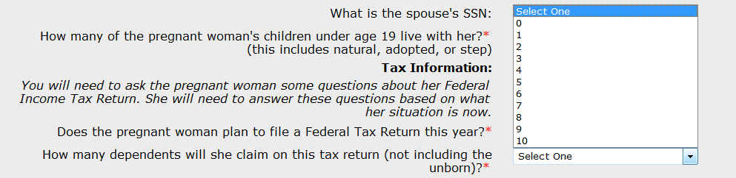
Presumptive Eligibility Tool ILT: PW and CH
Lesson 3: PE PW > Pregnant Woman Information Continued
There are several dropdowns in the Tax Information section. When the Pregnant Woman indicates that she intends to file a Federal Tax Return, a dropdown appears to indicate how many dependents she will claim on her return. The unborn is not included in the number of dependents the Pregnant Woman will claim.
In most situations, the number of dependents the consumer will claim on their tax return will match the number of children in the home. If a consumer is claiming additional dependents that aren’t part of the Tool, this needs to be captured as it may impact their eligibility.

Slide 38
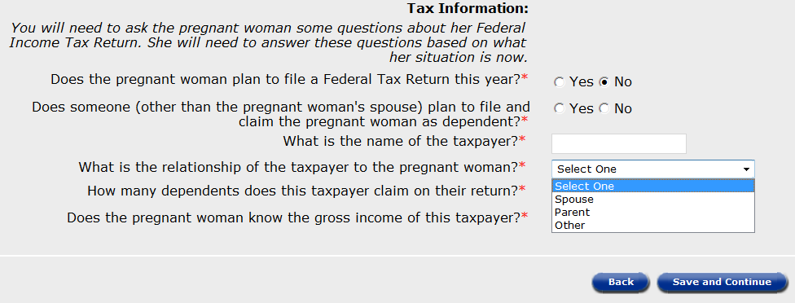
Presumptive Eligibility Tool ILT: PW and CH
Lesson 3: PE PW > Pregnant Woman Information Continued
When the Pregnant Woman reports that she won’t file a tax return and someone other than her Spouse will claim her as a dependent a field for the name of taxpayer displays. A dropdown follows requesting the taxpayer’s relationship to the Pregnant Woman.

Slide 39
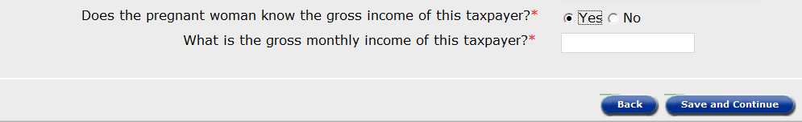
Presumptive Eligibility Tool ILT: PW and CH
Lesson 3: PE PW > Pregnant Woman Information Continued
The last questions on this page deal with the taxpayer’s gross income which is needed to determine if the Pregnant Woman qualifies for PE. A text box displays when the Pregnant Woman indicates that she knows the taxpayer’s gross income.
If the Pregnant Woman doesn’t know the taxpayer’s gross income, she will be denied for PE.

Slide 40
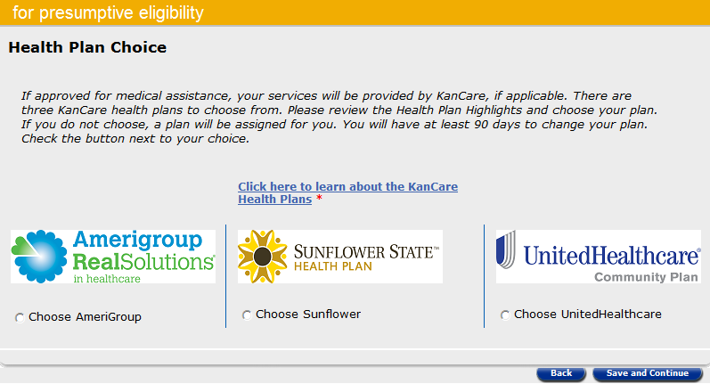
Presumptive Eligibility Tool ILT: PW and CH
Lesson 3: PE PW > Health Plan Choice
Health Plan Choice is the next page in the PE PW Tool. Unlike consumers approved for the other PE programs, those approved for PE PW will not be enrolled in KanCare. This is because the PE PW benefit package is limited and doesn’t include all medical benefits.
QE staff need to choose a Health Plan on this page only because it’s needed in order to move to the next page in the Tool. QE staff should not discuss the KanCare choices with the pregnant woman to avoid misleading her about her benefits.

Slide 41
Presumptive Eligibility Tool ILT: PW and CH
Lesson 3: PE PW > Summary
The Summary page is next. All of the data entered on the following pages is displayed:
Primary Applicant
Pregnant Woman Information
Pregnant Woman Information Continued
QE staff need to thoroughly review this page to ensure that all of the pregnant woman’s data is correct. If an error is found, click the Edit button for the appropriate page to enter the correct information.
Once all the information is correct, click the Calculate button to determine if the pregnant woman qualifies for PE PW.

Slide 42
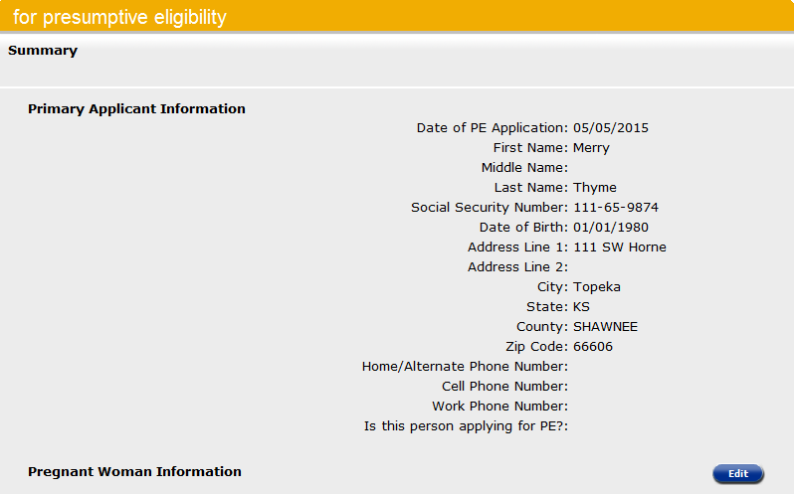
Presumptive Eligibility Tool ILT: PW and CH
Lesson 3: PE PW > Summary > Primary Applicant Information
Primary Applicant Information is the first part of the Summary page. Use the Edit button to correct or add information to the Primary Applicant.

Slide 43
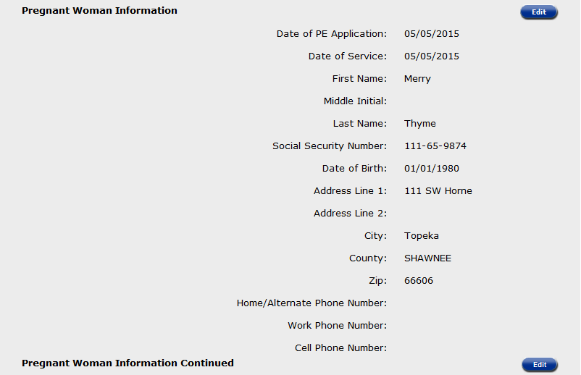
Presumptive Eligibility Tool ILT: PW and CH
Lesson 3: PE PW > Summary > Pregnant Woman Information
Pregnant Woman Information is the next section displayed. Use the Edit button to correct or add information to the Primary Applicant.

Slide 44
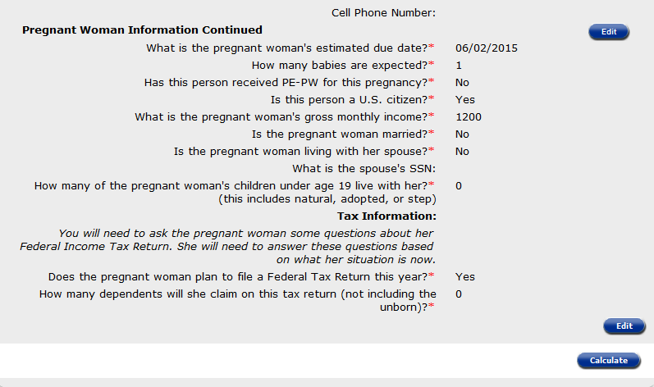
Presumptive Eligibility Tool ILT: PW and CH
Lesson 3: PE PW > Summary > Pregnant Woman Info Continued
The last section of the Summary Page is Pregnant Woman Information Continued. Once again, the Edit button can be used to change or update any of the Pregnant Woman’s information. If everything on the Summary page is correct, click the Calculate button.

Slide 45
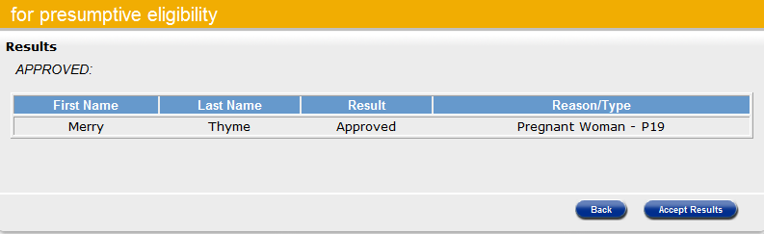
Presumptive Eligibility Tool ILT: PW and CH
Lesson 3: PE PW > Results Page
The Results page is displayed. On this page the:
Results column indicates if the pregnant woman was approved or denied for PE PW coverage.
Reason/Type column indicates the pregnant woman’s coverage type or the reason she was denied.

Slide 46
Presumptive Eligibility Tool ILT: PW and CH
Lesson 3: PE PW > Results Page
At this point, you can choose to click one of the following buttons:
Accept Results as the PE Tool data and determination are correct
Back button to return to the Summary page
  Review the data to ensure it’s correct
  Edit the appropriate page if needed

Slide 47
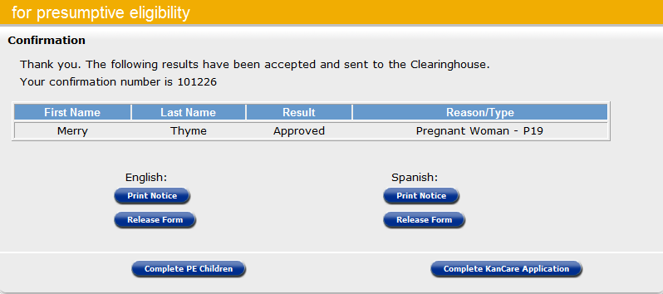
Presumptive Eligibility Tool ILT: PW and CH
Lesson 3: PE PW > Confirmation Page
The Confirmation Page displays after the results of the PE Tool have been accepted. An important field on this page is the confirmation number. This number will be displayed on all PE forms as well as the accompanying KanCare application when it’s filed through the MCSSP. Take note of this number as it will be needed for the notice.

Slide 48
Presumptive Eligibility Tool ILT: PW and CH
Lesson 3: PE PW > Confirmation Page
In addition to the pregnant woman’s name, result, and reason/type the Confirmation page allows staff to print the following:
English
Release Form
Spanish
Release Form
The notice created from the PE Tool will not be used for the PE PW program. Policy has created a special electronic template that must be used when determining PE PW. It is essential that QE staff use the template provided so the pregnant woman and providers receive the correct information regarding her benefits.

Slide 49
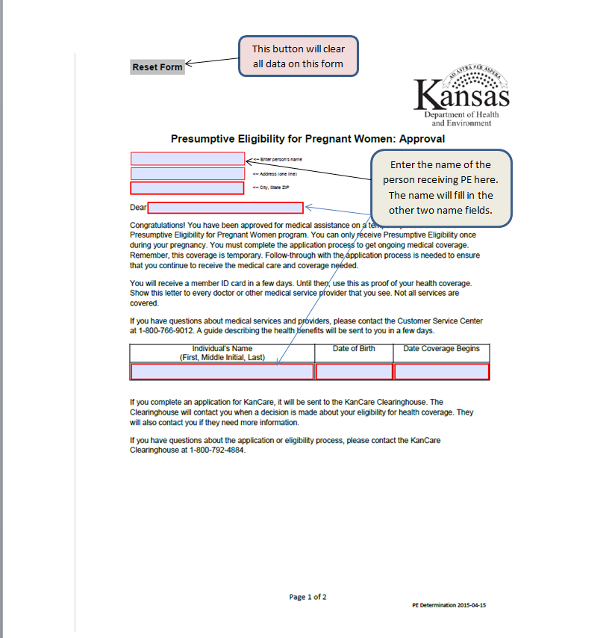
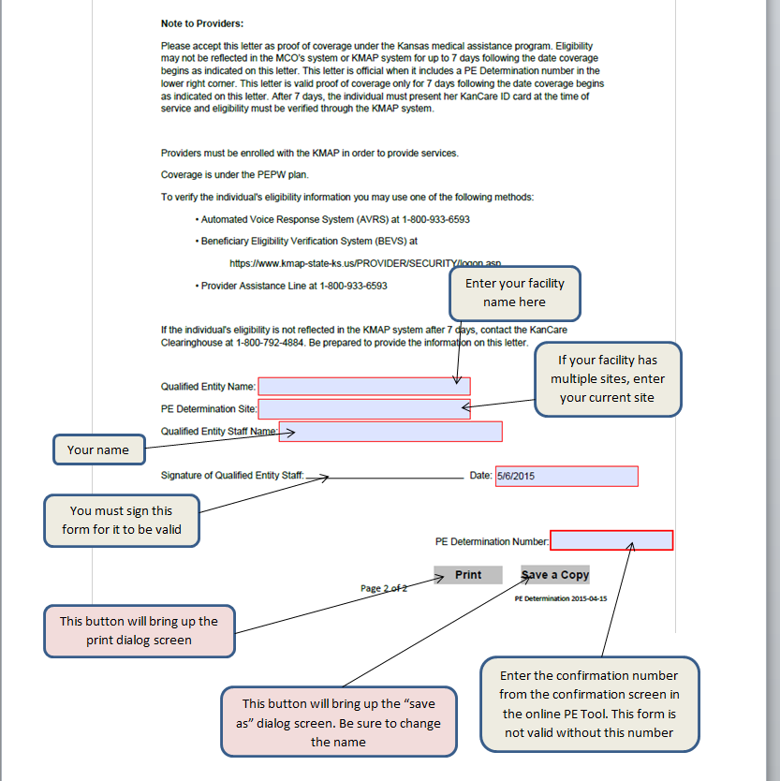
Presumptive Eligibility Tool ILT: PW and CH
Lesson 3: PE PW > Confirmation Page > Notices
The instructions for the PE PW notice are provided below. The Confirmation Number from the PE Tool is entered on the second page of the notice.

Slide 50
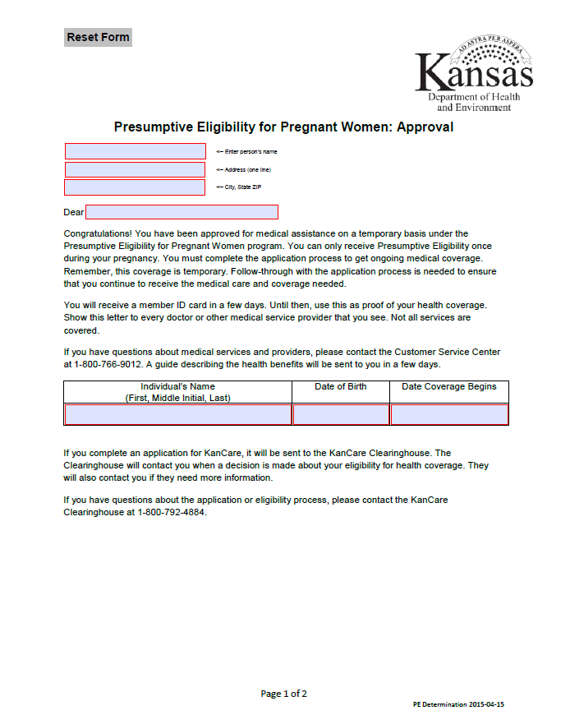
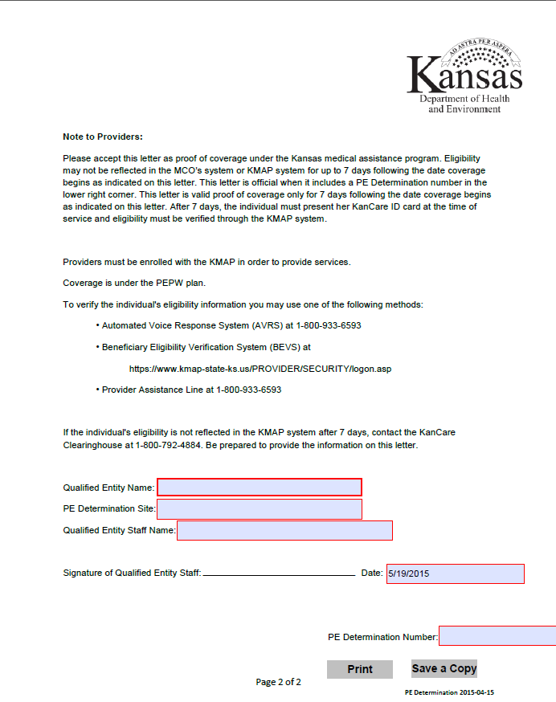
Presumptive Eligibility Tool ILT: PW and CH
Lesson 3: PE PW > Confirmation Page > Notices
Here is a blank PE PW notice template. Remember that when a PE PW Tool is completed, the consumer should always be given a copy of the approval or denial notice. In addition, a copy of the PE PW notice must be faxed to the KanCare Clearinghouse.

Slide 51
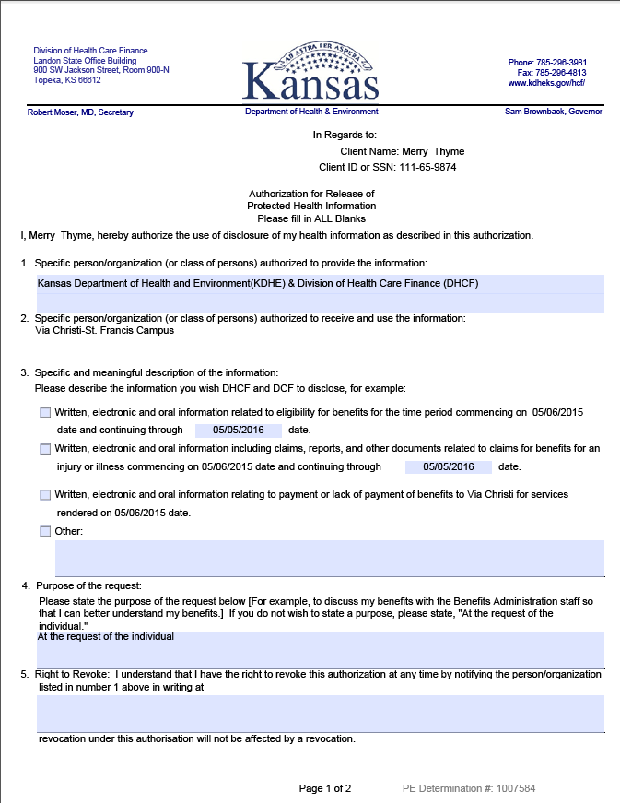
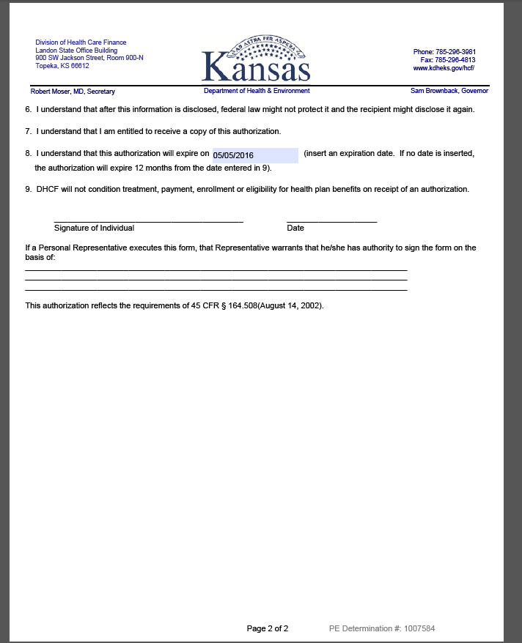
Presumptive Eligibility Tool ILT: PW and CH
Lesson 3: PE PW > Confirmation Page > Release Form
Continue to use the Release Form in the PE Tool when a consumer wants QE Staff to communicate with the KanCare Clearinghouse about her application. This too must be faxed to the KanCare Clearinghouse.

Slide 52
Presumptive Eligibility Tool ILT: PW and CH
Lesson 3: PE PW > Confirmation Page > Navigation
Once the PE PW determination process is complete, staff may choose to complete a:
PE Tool for Children
KanCare Application for the Pregnant Woman and/or the Household
Remember that information from the PE PW Tool will auto-populate to the PE CH Tool as well as the Self-Service Portal KanCare application

Slide 53
Presumptive Eligibility Tool ILT: PW and CH
Lesson 3: PE PW > Confirmation Page > Navigation
You can also click the KanCare logo in the left-hand corner of the page. This will return the user to the Overview page.

Slide 54
Presumptive Eligibility Tool ILT: PW and CH
Lesson 3: Summary
Lesson 3 is now complete. In this lesson, information regarding the PE PW Tool was reviewed, including the:
  Tool Page Flow
  Tool Pages
  Page Requirements
  Navigation from the Tool
The PE CH Tool will be discussed next.

Slide 55
Presumptive Eligibility Tool ILT: PW and CH
Agenda
Lesson 1: Overview
Lesson 2: PE Tool Basics
Lesson 3: PE PW
Lesson 4: PE CH
Lesson 5: MCSSP
Lesson 6: Administrative Features

Slide 56
Presumptive Eligibility Tool ILT: PW and CH
Lesson 4: PE CH > How To Get There
There are several ways to navigate to the PE for Children Tool. Pages that lead to the PE CH Tool are:
Primary Applicant
PE PW Confirmation
PE Adult Confirmation (only for QE Hospital Staff who have taken the necessary training)

Slide 57
Presumptive Eligibility Tool ILT: PW and CH
Lesson 4: PE CH > PE PW Tool Screen Flow
Below is the screen flow of the PE CH Tool. In this example the PE CH Tool originates from the Primary Applicant page.

Slide 58
Presumptive Eligibility Tool ILT: PW and CH
Lesson 4: PE CH > Primary Applicant Information
As stated earlier, all PE Tools start with the Primary Applicant Information page.
The QE Staff and QE auto-populate based on the user’s login information.
Select the appropriate PE Determination Site.
The Date of PE Application only populates after the Results have been accepted.
The following information is needed for the Primary Applicant Information:
First and Last Name
Date of Birth
Gender
Address
Applying for Self
Providing a Social Security Number is optional.

Slide 59
Presumptive Eligibility Tool ILT: PW and CH
Lesson 4: PE CH > Primary Applicant Information
Once the Primary Applicant Information page has been completed, click the PE Children button.
Remember to start with the PE PW Tool when you both the pregnant woman and her children are applying for PE.

Slide 60
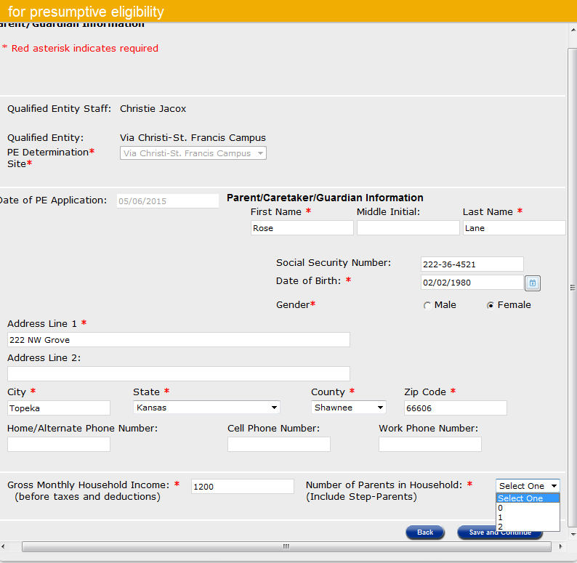
Presumptive Eligibility Tool ILT: PW and CH
Lesson 4: PE CH > Parent Guardian Information
The first page in the PE CH Tool is Parent Guardian Information. This page is used to collect information regarding the parents or caretakers of the children who are applying for PE coverage. In most situations information for the Primary Applicant and Parent Guardian will be the same.
The following information is needed for the Parent Guardian:
First and Last Name
Date of Birth
Gender
Address
Gross Monthly Income
Number of Parents
Providing a Social Security Number is optional.
The PE Determination Site auto-populates from the Primary Applicant page.
The Date of PE Application only populates after the Results have been accepted.

Slide 61
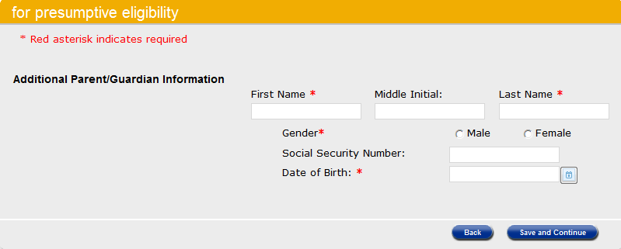
Presumptive Eligibility Tool ILT: PW and CH
Lesson 4: PE CH > Additional Parent Guardian Information
The maximum number of parents allowed in a household is 2.
The Additional Parent/Guardian Information page displays when 2 is chosen from the Number of Parents in the Household dropdown.
The following information is needed for the Additional Parent Guardian:
First and Last Name
Gender
Date of Birth
Address
Providing a Social Security Number is optional.

Slide 62
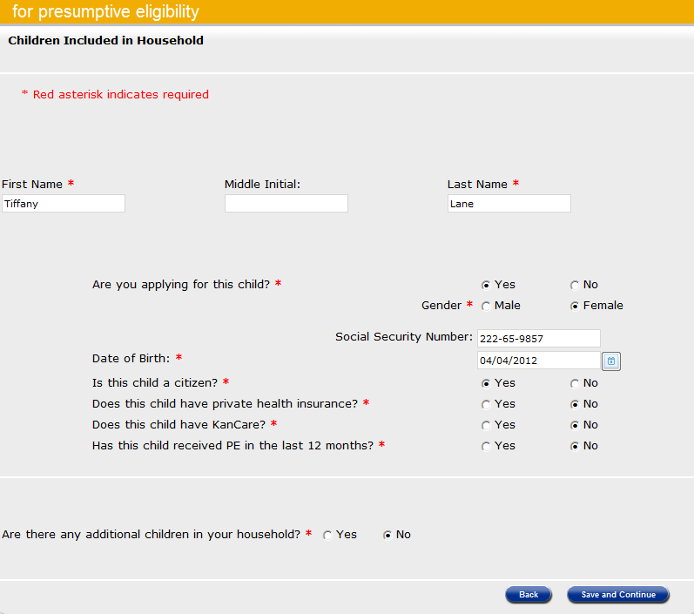
Presumptive Eligibility Tool ILT: PW and CH
Lesson 4: PE CH > Children Included in the Household
The next page displayed is Children Included in the Household.
The following information is needed for the children:
First and Last Name
Applying for child?
Gender
Date of Birth
US Citizen/Eligible Non-Citizen
Private Health Insurance
Current KanCare Coverage
Previous PE in Last 12 Months
Providing a Social Security Number is optional.

Slide 63
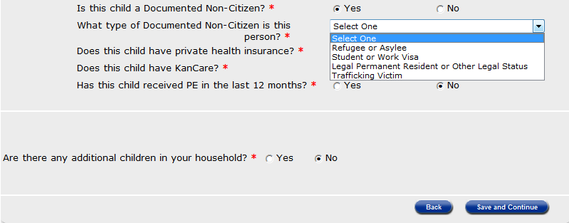
Presumptive Eligibility Tool ILT: PW and CH
Lesson 4: PE CH > Children Included in the Household
If the child is not a U.S. Citizen and Yes is selected for the Is this person a Documented Non-Citizen question, a dropdown will display with the values listed below.
If Yes is indicated for the Are there any additional children in your household question, this page will redisplay blank. Complete a Children Included in the Household Page for each child in the household. When all of the children have been added click the Save and Continue button.

Slide 64
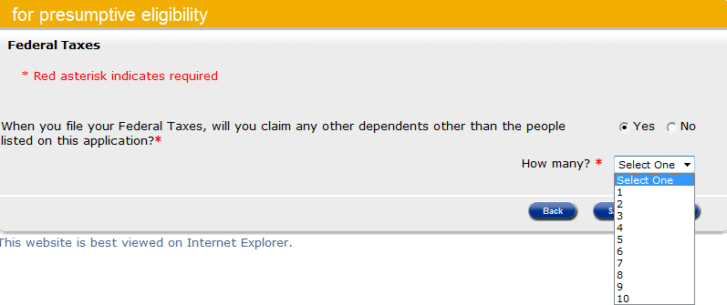
Presumptive Eligibility Tool ILT: PW and CH
Lesson 4: PE CH > Federal Taxes Page
Federal Taxes is the next page. If the Parent Guardian indicates they will claim dependents other than those listed on the PE Tool, a dropdown menu displays. Choose the number of additional dependents the Parent Guardian will claim through the How Many dropdown menu. Click Save and Continue to go to the next page.

Slide 65
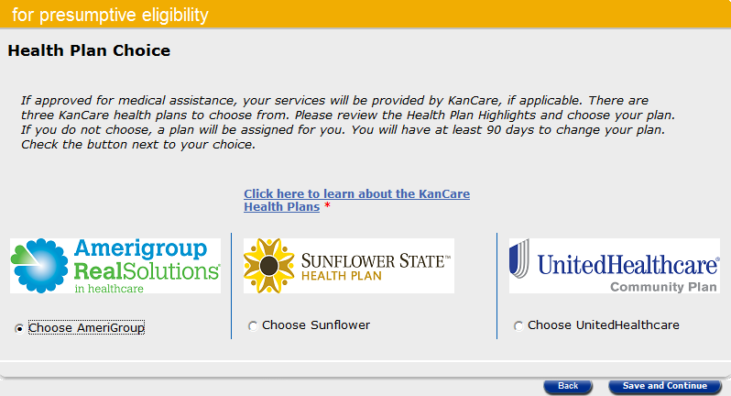
Presumptive Eligibility Tool ILT: PW and CH
Lesson 4: PE CH > Health Plan Choice
Health Plan Choice is the next page. Use this page to indicate which KanCare health plan the parent or caretaker selects for the children.

Slide 66
Presumptive Eligibility Tool ILT: PW and CH
Lesson 4: PE CH > Summary
The Summary page is next. All of the data entered on the following pages is displayed:
Primary Applicant Information
Parent/Guardian Information
Children Included in Household
QE staff need to thoroughly review this page to ensure that all of the information is correct. If an error is found, click the Edit button for the appropriate page to enter the correct information.
Once all the information is correct, click the Calculate button to determine if the child qualifies for PE CH.

Slide 67
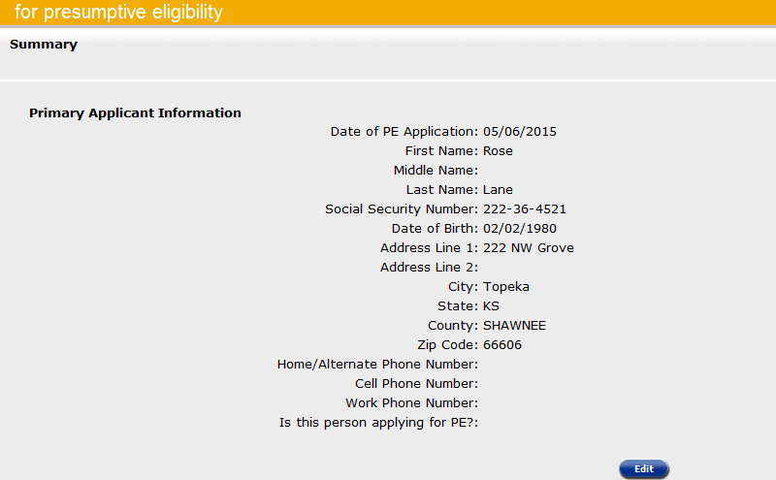
Presumptive Eligibility Tool ILT: PW and CH
Lesson 4: PE CH > Summary
Primary Applicant Information is the first part of the Summary page. Use the Edit button to correct or add information to the Primary Applicant.

Slide 68
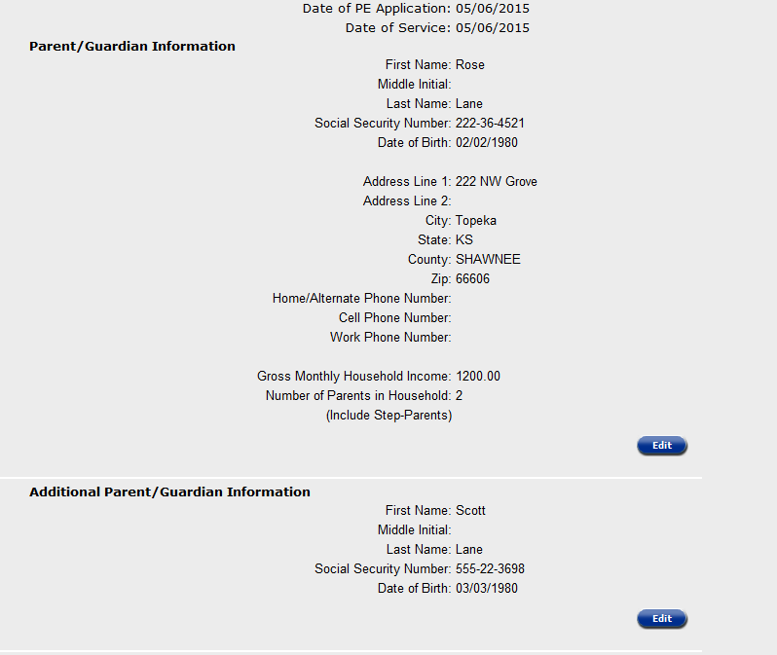
Presumptive Eligibility Tool ILT: PW and CH
Lesson 4: PE CH > Summary
The Parent/Guardian Information and Additional Parent/Guardian Information are next. Use the Edit button to correct or add information to the Parent/Guardian or Additional Parent/Guardian.

Slide 69
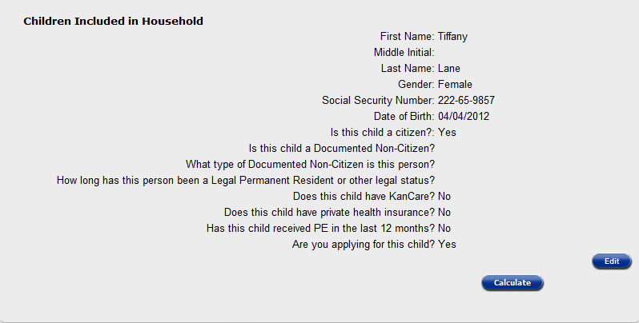
Presumptive Eligibility Tool ILT: PW and CH
Lesson 4: PE CH > Summary
Children Included in the Household is the last section of the Summary page. Review each child’s information to ensure that it is correct. Click the Edit button to correct or add a child’s information.
Once all of the information on the Summary page is correct, click the Calculate button to determine the children’s eligibility.

Slide 70
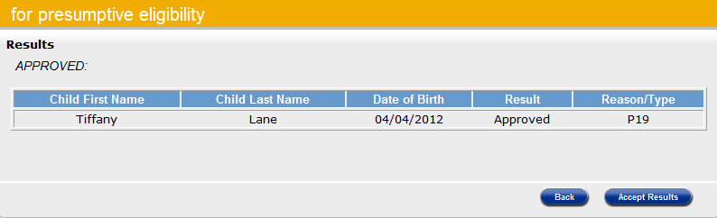
Presumptive Eligibility Tool ILT: PW and CH
Lesson 4: PE CH > Results
The Results page is displayed. On this page the:
Results column indicates if the child was approved or denied for PE CH coverage.
Reason/Type column indicates the child’s coverage type or the reason she was denied.
Type of coverage for the PE CH program is:
  Title 19 (P19) PEN/CH/N/N
  Title 21 (P21) PET/CH/N/N

Slide 71
Presumptive Eligibility Tool ILT: PW and CH
Lesson 4: PE CH > Potential Results
Potential Results
Approval
Denial
Partial Approval/Denial

Slide 72
Presumptive Eligibility Tool ILT: PW and CH
Lesson 4: PE CH > Results
At this point, you can choose to click one of the following buttons:
Accept Results as the PE Tool data and determination are correct
Back button to return to the Summary page
  Review the data to ensure it’s correct
  Edit the appropriate page if needed

Slide 73
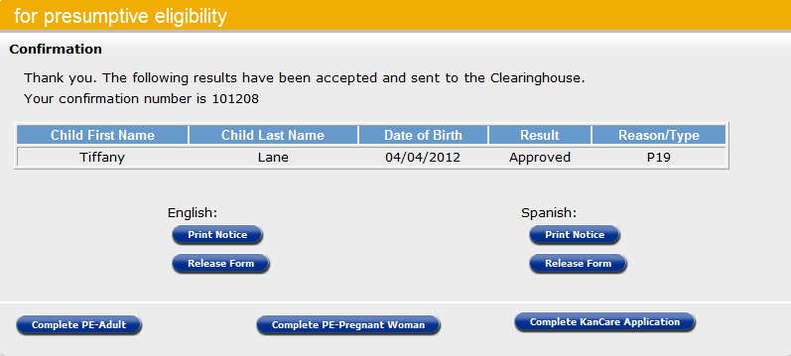
Presumptive Eligibility Tool ILT: PW and CH
Lesson 4: PE CH > Confirmation
The Confirmation Page displays after the results of the PE Tool have been accepted. An important field on this page is the confirmation number. This number will be displayed on all PE forms as well as the accompanying KanCare application when it’s filed through the MCSSP.

Slide 74
Presumptive Eligibility Tool ILT: PW and CH
Lesson 4: PE CH > Confirmation
In addition to the child’s name, result, and reason/type the Confirmation page allows staff to print the:
English
Approval or Denial Notice
Release Form
Spanish
Approval or Denial Notice
Release Form

Slide 75
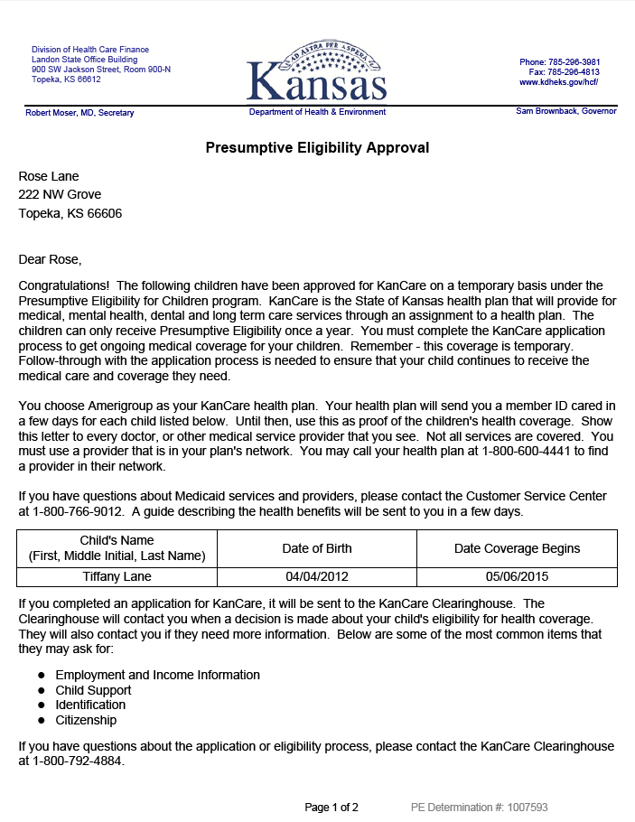
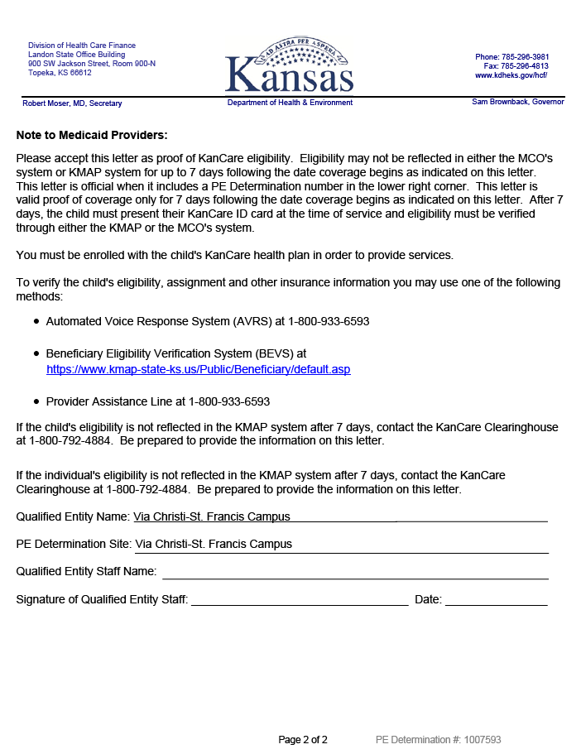
Presumptive Eligibility Tool ILT: PW and CH
Lesson 4: PE CH > Confirmation Page > Notices
Remember that when a PE Tool is completed, a consumer should always be given a copy the approval or denial notice.

Slide 76
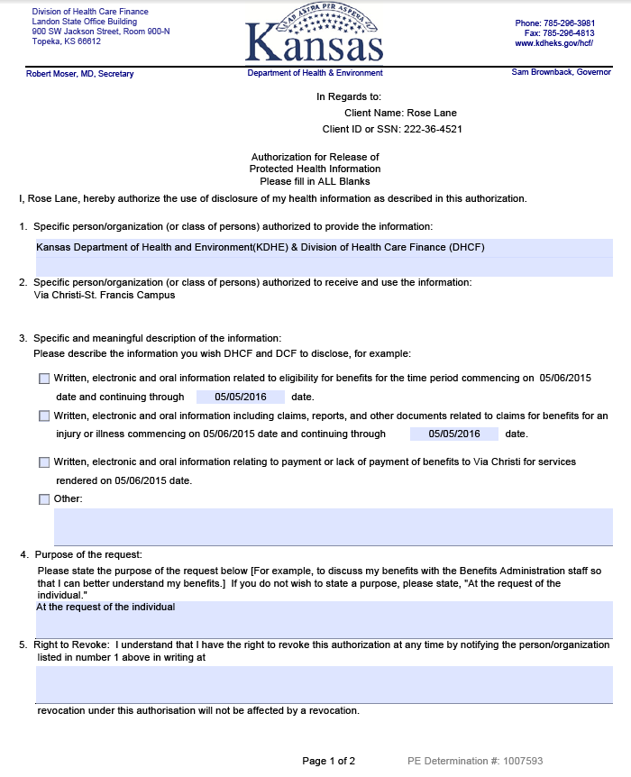
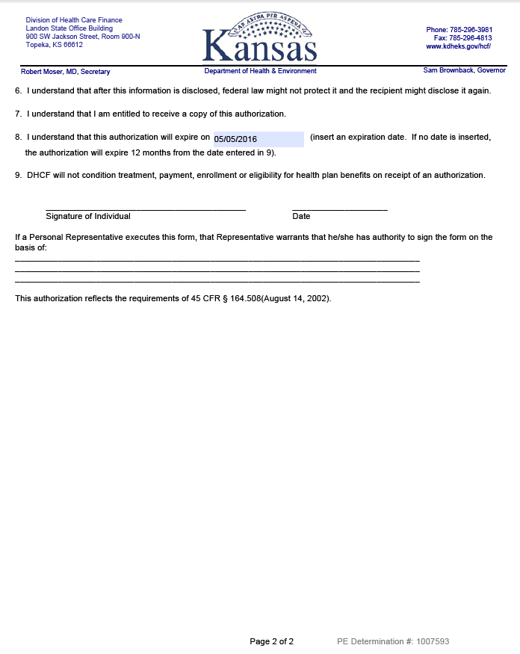
Presumptive Eligibility Tool ILT: PW and CH
Lesson 4: PE CH > Confirmation Page > Release Form
Continue to use the Release Form in the PE Tool when a consumer wants QE Staff to communicate with the KanCare Clearinghouse about her application. This too must be faxed to the KanCare Clearinghouse.

Slide 77
Presumptive Eligibility Tool ILT: PW and CH
Lesson 4: PE CH > Confirmation Page > Navigation
Once the PE CH determination process is complete, staff may choose to complete a KanCare Application for the Child and/or Household. Information from the PE CH Tool will auto-populate to the Self-Service Portal KanCare application.
Although it’s possible to access the PE PW Tool from this page, the PE PW > PE CH flow should be followed when completing multiple Tools for a single household.
Staff can also click the KanCare log to return to the Overview page.

Slide 78
Presumptive Eligibility Tool ILT: PW and CH
Lesson 4: Summary
In Lesson 4 information the following information regarding the PE CH Tool was discussed:
  Tool Page Flow
  Tool Pages
  Page Requirements
  Navigation from the Tool
Completing a KanCare application in the Medical Consumer Self-Service Portal (MCSSP) will be discussed next.

Slide 79
Presumptive Eligibility Tool ILT: PW and CH
Agenda
Lesson 1: Overview
Lesson 2: PE Tool Basics
Lesson 3: PE PW
Lesson 4: PE CH
Lesson 5: MCSSP
Lesson 6: Administrative Features

Slide 80

Presumptive Eligibility Tool ILT: PW and CH
Lesson 5: MCSSP
Once the PE Tool determination has been accepted and the Confirmation page displays, you will have the option to navigate to the Medical Consumer Self-Service Portal (MCSSP) to help the consumer complete the KanCare application.

Slide 81
Presumptive Eligibility Tool ILT: PW and CH
Lesson 2: PE Tool Basics > Login Page > MCSSP Links
An overview of the different sections of the MCSSP is listed below.
Check Eligibility
A self-assessment to check for potential eligibility.
Apply for Medical Assistance
Web-based application for all medical programs.
Access my KanCare
Access to submitted MCSSP applications.

Slide 82
Presumptive Eligibility Tool ILT: PW and CH
Lesson 5: MCSSP > Benefits
There are several benefits to applying through the MCSSP. When the MCSSP is used immediately following the PE Tool determination:
Information from the Tool, such as Names, Dates of Birth, and Social Security Numbers, auto-populates the MCSSP application.
The MCSSP’s Confirmation Number matches that of the PE Tool, thereby linking them together.

Slide 83
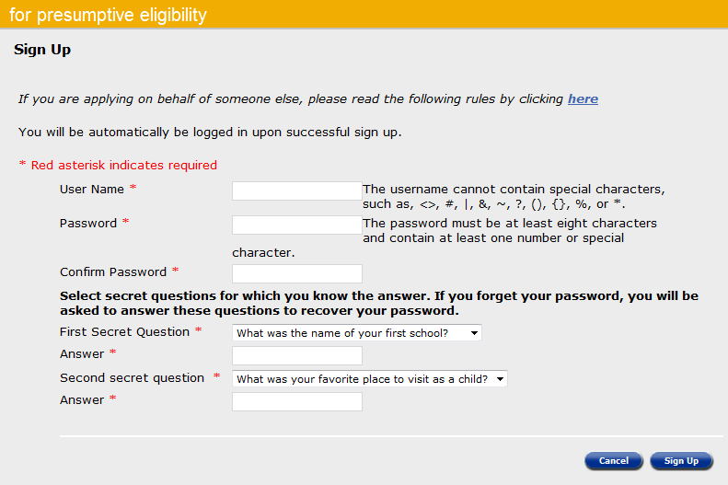
Presumptive Eligibility Tool ILT: PW and CH
Lesson 5: MCSSP > Sign Up Page
In order to complete an application through the MCSSP, the consumer must sign up. A consumer must have an email account, so it will be necessary to help them set one up in some situations.
The following information is needed to set up an account in the MCSSP:
User Name
Password
Confirm Password
1st Secret Question and Answer
2nd Secret Question and Answer

Slide 84
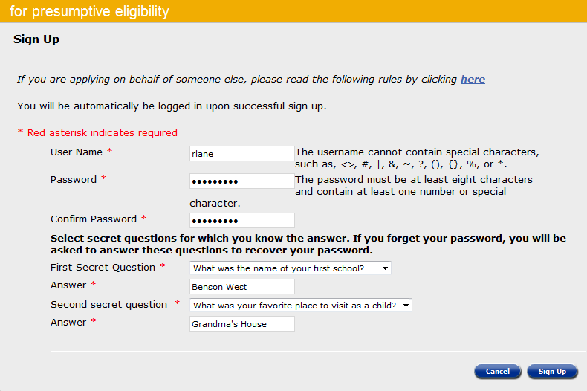
Presumptive Eligibility Tool ILT: PW and CH
Lesson 5: MCSSP > Sign Up Page
The MCSSP User Name can’t contain any special characters (# & * < % >).
The Password must be:
8 characters
Contain 1 special number or special character

Slide 85
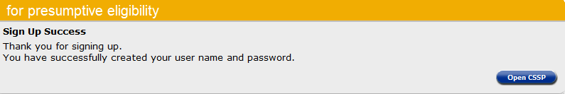
Presumptive Eligibility Tool ILT: PW and CH
Lesson 5: MCSSP > Sign Up Page
A message will display when a new MCSSP account has been set up successfully. After this, you can assist the consumer through the MCSSP KanCare application.
Click the Open CSSP button to return to the MCSSP Homepage. The consumer will need to enter their User Name and Password to open the MCSSP.

Slide 86
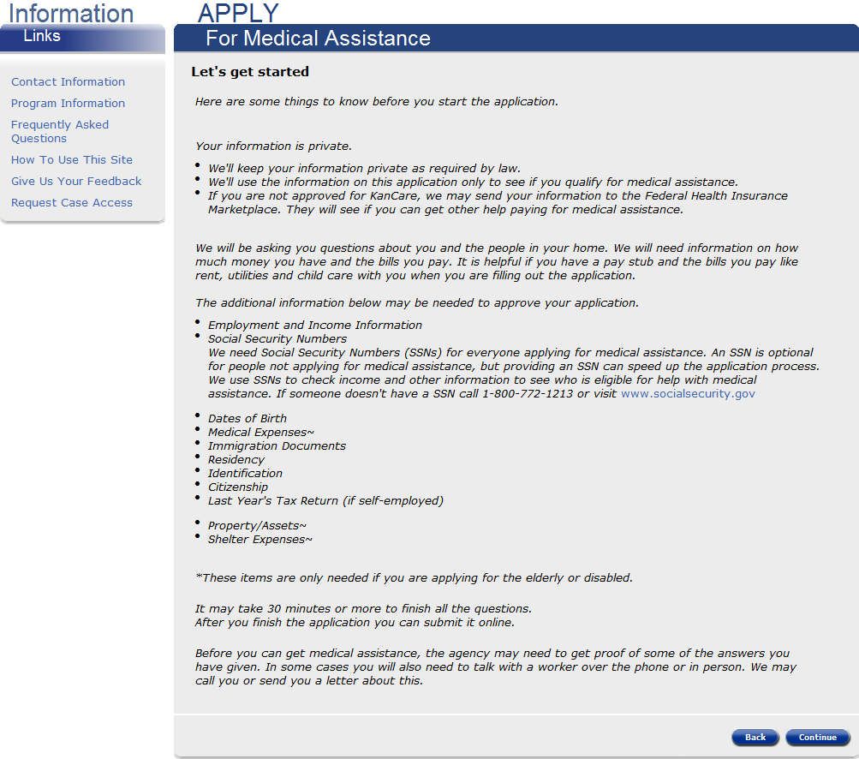
Presumptive Eligibility Tool ILT: PW and CH
Lesson 5: MCSSP > Sign Up Page
An Overview page displays first. This page explains how the consumer’s information will be used as well as what information will be needed in order to determine their eligibility for KanCare.
The Information Links Menu to the left can be accessed at anytime.

Slide 87
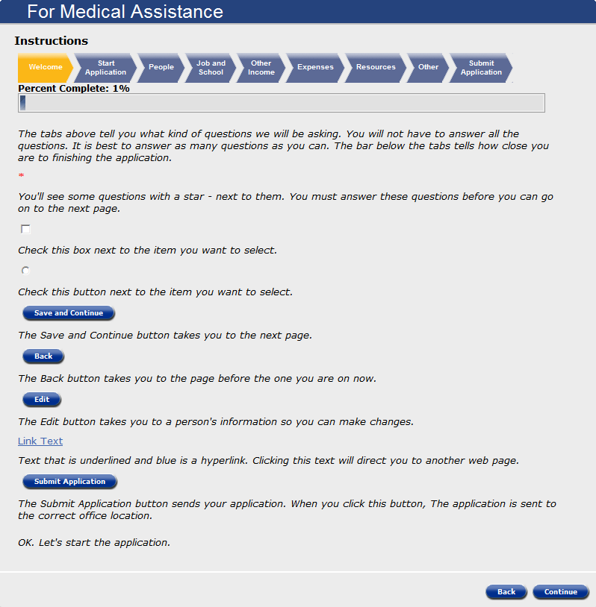
Presumptive Eligibility Tool ILT: PW and CH
Lesson 5: MCSSP > Instructions
The following page explains how to navigate throughout the MCSSP. The chevrons located at the top of the page indicate the topics of each section of the MCSSP. Beneath this is a progress bar that displays how much of the MCSSP application the consumer has completed.
We’ll walk through one section of the application to get a feel for how it functions.

Slide 88
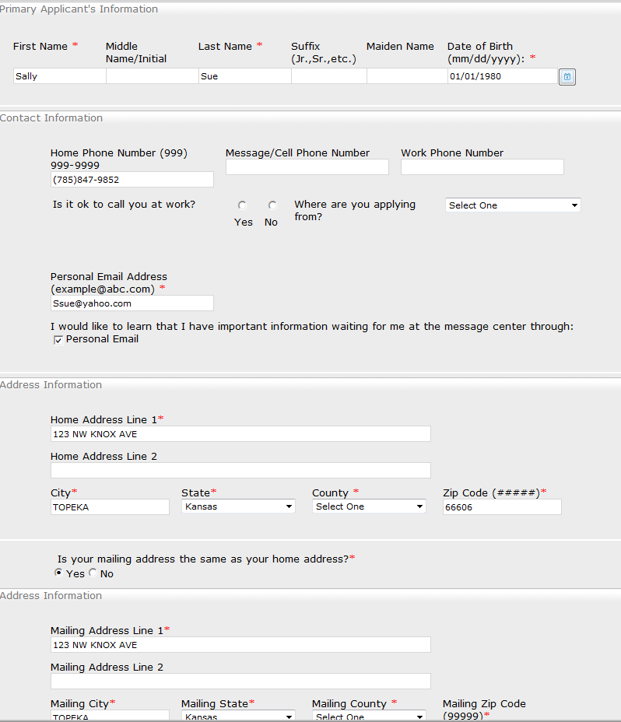
Presumptive Eligibility Tool ILT: PW and CH
Lesson 5: MCSSP > Primary Applicant Information Page
Like the PE Tools, the first page of the MCSSP is Primary Applicant Information.
Information the consumer entered when signing up for the MCSSP auto-populates on the Primary Applicant’s Information Page.
Select the County Code from the dropdown menu in the Home and Mailing Address sections.

Slide 89


Presumptive Eligibility Tool ILT: PW and CH
Lesson 5: MCSSP > Tell Us More and Background Information
Tell Us More and Background Information pages will need to be completed for every member of the primary applicant’s household.
Information needed in this section includes:
Applying for Self
SSN
Alias Names
Language Spoken
Language Read
Other Communication Needs

Slide 90

Presumptive Eligibility Tool ILT: PW and CH
Lesson 5: MCSSP > Start Application Summary
After all the pages of a section have been completed, a Summary page will display. Check all of the data entered to ensure it’s correct. If information is missing or needs to be corrected, click the Edit button in the appropriate section. When all of the information on the Summary screen is correct, click Save and Continue to proceed with the application.

Slide 91

Presumptive Eligibility Tool ILT: PW and CH
Lesson 5: MCSSP > Progressing Through the Application
Adding information about all of the people living in the primary applicant’s home follows. Once all persons have been added, the application will progress through each section. Answer all questions that apply to the household. At any point in the process, the Save and Exit button can be used allowing the consumer to complete and submit the application at a later time.

Slide 92
Presumptive Eligibility Tool ILT: PW and CH
Lesson 5: MCSSP > Summary
Lesson 5 presented information concerning the MCSSP KanCare application including the:
  Benefits
  Sign Up Process
  Navigation
Administrative Features of the PE Tool will be discussed in our last lesson.

Slide 93
Presumptive Eligibility Tool ILT: PW and CH
Agenda
Lesson 1: Overview
Lesson 2: PE Tool Basics
Lesson 3: PE PW
Lesson 4: PE CH
Lesson 5: MCSSP
Lesson 6: Administrative Features

Slide 94
Presumptive Eligibility Tool ILT: PW and CH
Lesson 6: Administrative Features
In addition to completing PE determinations the Tool has several administrative features which are important to know.
Administrative
Security Roles
System Timeout
My PE Applications

Slide 95
Presumptive Eligibility Tool ILT: PW and CH
Lesson 6: Administrative Features > Security Roles
There are 2 PE security roles for Qualified Entity staff.
QE Staff
Access to the PE Tool
Ability to view PE Tools they have worked on
QE Supervisor
Access to the PE Tool
Ability to view all PE Tools completed by staff at their QE agency

Slide 96
Presumptive Eligibility Tool ILT: PW and CH
Lesson 6: Administrative Features > Security Roles
An additional security role of QE Superuser is assigned to Policy and Eligibility staff. This role provides Policy and Eligibility staff with access to the PE Tools created by all Qualified Entities.

Slide 97

Presumptive Eligibility Tool ILT: PW and CH
Lesson 6: Administrative Features > System Timeout
Another important feature to be aware of is System Timeout. The PE Tool will automatically timeout a user when there’s been no activity for 25 minutes. It will provide you with a warning message 5 minutes prior to timeout. Clicking the ‘Continue Working’ button will stop the timeout process. If the button isn’t clicked, the timeout will occur, returning the user to the Log-in page.

Slide 98
Presumptive Eligibility Tool ILT: PW and CH
Lesson 6: Administrative Features > System Timeout
The system will not automatically save the last page you accessed if new data was entered. However, any work completed on prior pages will be saved. Upon logging back in, the system will always bring you to the Presumptive Eligibility (PE) Overview page rather than where you left off.

Slide 99

Presumptive Eligibility Tool ILT: PW and CH
Lesson 6: Administrative Features > My PE Applications
The My PE Applications is a link that can be accessed once a user is logged into the Tool. This feature allows a user to view all of the PE Tools they have worked on.

Slide 100

Presumptive Eligibility Tool ILT: PW and CH
Lesson 6: Administrative Features > My PE Applications
The From and To fields in Search by Date of Service are populated with default values. QE staff can change these dates to expand or narrow their search by using the text box feature or clicking on the calendar icon.

Slide 101

Presumptive Eligibility Tool ILT: PW and CH
Lesson 6: Administrative Features > My PE Applications
Additional values that can be used to search are:
Status
  Incomplete
  Denied
  Approved
  Approved/Denies
  Expired
Last Name of Primary Applicant
PE Tool Type
  PW
  CH
  Adult
Click the Search button when all of the criterial has been entered.

Slide 102
Presumptive Eligibility Tool ILT: PW and CH
Lesson 6: Administrative Features > My PE Applications
When more than one result is returned, arrows or carets located in the column headers can be used to redisplay the data from bottom to top and vice versa.

Slide 103
Presumptive Eligibility Tool ILT: PW and CH
Wrap up
In this course, we learned about:
Goals of Presumptive Eligibility
Basics of the PE Tool
PE for Pregnant Woman Tool
PE for Children Tool
Medical Consumer Self-Service Portal
Various Administrative Features in the Tool

Slide 104

Presumptive Eligibility Tool ILT: PW and CH
Questions
If you have further questions regarding the Presumptive Eligibility program, please email them to Training@KEES.KS.gov .

